Slide 1
CHAPTER 5
Developing the Schedule
© 2018 Cengage®. May not be scanned, copied or duplicated, or posted to a publicly accessible website, in whole or in part, except for use as permitted in a license distributed with a certain product or service or otherwise on a password-protected website or school-approved learning management system for classroom use.
Notes:
Teaching Strategies
There are two vignettes featured in this chapter. (See Premium Deck for Slides.)
The first vignette reinforces the need to interact with community members and key stakeholders when planning the schedule. Sometimes part of the solution of the project is the creation of other beneficial projects to help with buy in.
The second vignette reinforces that the first design of a project might not be the final plan. Complex projects require creative solutions to keep all the aspects on track and the project to be completed on time and within budget. Even though it had difficulties and a few failures at the start, the complex project was scheduled well.
Sometimes, when planning the schedule, calculated times are for activity completion are not accurate. This can become a problem when no one takes the time to examine the actual time it takes to complete activities.
Have students plan the amount of time that it would take to travel between two cities that are near campus. After they calculate the time to travel, have them think about how they would factor in extenuating circumstances (like a flat tire, the need to refill the fuel tank, the need to stop for food, or a traffic-blocking accident).
Have students calculate the ES, EF, LS, and LF times in class to be sure they understand what it means to calculate forward and to calculate backward.
The ES, EF, LS, LF times on the network diagram for the consumer market study are included in the chapter materials. Have the students compare the textbook diagram with the schedule table in Microsoft Project.
Have the students report on the similarities and the differences.

Slide 2
Chapter Concepts
Estimating the resources required for each activity
Estimating the duration for each activity
Establishing the estimated start time and required completion time for the overall project
Calculating the earliest times at which each activity can start and finish, based on the project estimated start time
Calculating the latest times by which each activity must start and finish in order to complete the project by its required completion time
Determining the amount of positive or negative slack between the time each activity can start or finish and the time it must start or finish
Identifying the critical (longest) path of activities
Performing the steps in the project control process
Determining the effects of actual schedule performance on the project schedule
Incorporating changes into the schedule
Developing an updated project schedule
Determining approaches to controlling the project schedule
Implementing agile project management
Notes:
Chapter Concepts
This chapter discusses monitoring and controlling the progress of the project, re-planning, and updating the project schedule.
Once a project actually begins, it is necessary to monitor progress to ensure that everything goes according to schedule. This involves measuring actual progress and comparing it to the schedule.
If at any time during the project, it is determined that the project is behind schedule, corrective action must be taken to get back on schedule, which becomes increasingly difficult as a project falls further behind.
Based on the material in this chapter, students will become familiar with:
Estimating the resources required for each activity
Estimating the duration for each activity
Establishing the estimated start time and required completion time for the overall project
Calculating the earliest times at which each activity can start and finish, based on the project estimated start time
Calculating the latest times by which each activity must start and finish in order to complete the project by its required completion time
Determining the amount of positive or negative slack between the time each activity can start or finish and the time it must start or finish
Identifying the critical (longest) path of activities
Performing the steps in the project control process
Determining the effects of actual schedule performance on the project schedule
Incorporating changes into the schedule
Developing an updated project schedule
Determining approaches to controlling the project schedule
Implementing agile project management

Slide 3
Learning Outcomes
Estimate the resources required for activities
Estimate the duration for an activity
Determine the earliest start and finish times for activities
Determine the latest start and finish times for activities
Explain and determine total slack
Prepare a project schedule
Identify and explain the critical path
Discuss the project control process
Develop updated schedules based on actual progress and changes
Discuss and apply approaches to control the project schedule
Explain agile project management
Notes:
Learning Outcomes
After studying this chapter, students should be able to:
Estimate the resources required for activities
Estimate the duration for an activity
Determine the earliest start and finish times for activities
Determine the latest start and finish times for activities
Explain and determine total slack
Prepare a project schedule
Identify and explain the critical path
Discuss the project control process
Develop updated schedules based on actual progress and changes
Discuss and apply approaches to control the project schedule
Explain agile project management

Slide 4
Project Integration Management Project Resource Management Project Schedule Management
Project Management Knowledge Areas from PMBOK® Guide
Notes:
Project Management Knowledge Areas from PMBOK® Guide
Concepts in this chapter support the following Project Management Knowledge Areas of the PMI Guide to the Project Management Body of Knowledge (PMBOK® Guide):
Project Integration Management
Project Resource Management Project Schedule Management

Slide 5
Estimate Activity Resources
Resources include
People, materials, equipment, facilities
Influence on the duration
Availability of the resources
Types of resources
Sufficient quantities of resources for the activity durations
Potential conflicts with other projects may cause
Involve person with expertise in resource estimate
Estimates influence costs
Notes:
Estimate Activity Resources
It is necessary to estimate the types and quantities of resources that will be required to perform each specific activity in a project.
Resources include people, materials, equipment, facilities, and so forth.
Having this information is essential in estimating how long it will take to perform each activity and the project as a whole.
A number of factors influence the duration of an activity:
Availability of the resources
Types of resources
Sufficient quantities of resources for the durations of the activities
Potential conflicts with other projects that may cause a delay
When estimating the types and quantities of resources required for each specific activity, it is valuable to involve a person who has expertise or experience with the activity.
Estimated activity resources will also be used later for estimating activity costs and determining the project budget.

Slide 6
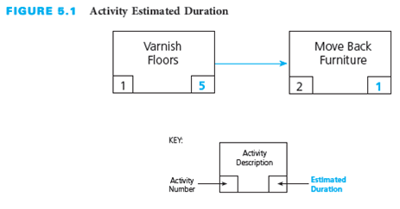
Estimate Activity Durations
Duration must be the total elapsed time
Time for the work to be done plus any associated waiting time
Notes:
Estimate Activity Durations
Once the types and quantities of resources are estimated for each activity, estimates can be made for how long it will take to perform the activities.
The estimated duration for each activity must be the total elapsed time—the time for the work to be done plus any associated waiting time.
The figure above depicts the activity estimated duration for varnishing floors.
It is a good practice to have the person who will be responsible for performing a specific activity estimate the duration for that activity.
Builds buy-in from the person and generates commitments
Avoids bias that may be introduced by having one person estimate the durations for all of the activities
It is important to designate an experienced individual to estimate the durations for all the activities for which the organization or subcontractor is responsible in large projects.
Historical data can be used as a guide in estimating the durations of similar activities.
Estimated duration should be aggressive yet realistic.
Inflating estimated durations in anticipation of the project manager negotiating shorter durations is not a good practice.
Throughout the performance of the project, some activities will take longer than their estimated duration, others will take less time than estimated, and a very few may conform to the estimated duration exactly.
At the beginning of the project, it may not be possible to estimate the durations for all activities with a high level of confidence.
The project team can progressively elaborate the estimated durations as more information is becomes available to allow for more accurate estimated durations.

Slide 7
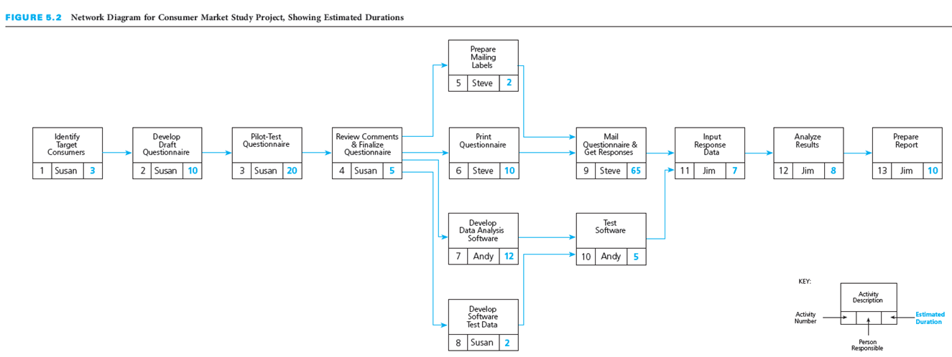
Estimate Activity Durations
Notes:
This figure depicts the network diagram for a consumer market study, with the estimated durations in days for each activity.
What are the realistic estimates for the activities shown?
What happens if an activity is delayed and will be its impact on the project?
What happens if an activity finishes early?

Slide 8
Establish Project Start and Finish Times
Define the overall window for project completion
May not want to commit to a specific date
Project not start until customer has approved the contract
Delay in contract signing may impact project start
Set finish time as number of days from project start
Notes:
Establish Project Start and Finish Times
It is necessary to select an estimated start time and a required completion time for the overall project. This is important in order to establish a basis from which to calculate a schedule using the estimated durations for the activities.
Define the overall window, or envelope, of time in which the project must be completed.
The contractor may not want to commit to completing the project by a specific date until the customer has approved the contract.
A delay in signing will likely impact the start date of the project.
The finish time should be stated as a number of days from the start of the project.

Slide 9
Develop Project Schedule
Prior activities for schedule development
Estimate duration of each activity
Establish overall window of time for the project
Develop the schedule timetable
Earliest start and finish times based on estimated start date
Latest start and finish times based on required completion date
Notes:
Develop Project Schedule
Once you have an estimated duration for each activity in the network must determine (based on durations and sequence) whether the project can be realistically finished by the required completion time.
In order to do this, the contractor should estimate the duration of each activity.
He or she should establish an overall window of time for the project.
Develop a project schedule that provides a timetable for each activity and shows:
The earliest times (or dates) at which each activity can start and finish, based on the project estimated start time (or date)
The latest times (or dates) by which each activity must start and finish in order to complete the project by its required completion time (or date)

Slide 10
Earliest Start and Finish Times
Earliest start time (ES)
Earliest time at which a specific activity can begin
Earliest finish time (EF)
Earliest time by which a specific activity can be completed
EF = ES + Estimated Duration
Calculate forward through the network diagram
Notes:
A. Earliest Start and Finish Times
Earliest start time (ES) is the earliest time at which a specific activity can begin
It is calculated on the basis of the project estimated start time and the estimated durations of preceding activities.
Earliest finish time (EF) is the earliest time by which a specific activity can be completed
It is calculated by adding the activity’s estimated duration to the activity’s earliest start time
EF = ES + Estimated Duration
Calculate forward through the network diagram from the beginning of the project to the end of the project.

Slide 11
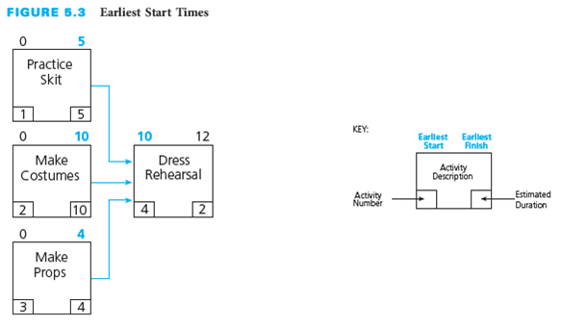
Earliest Start and Finish Times Calculation
Why is the ES for “Dress Rehearsal” 10?
Notes:
Earliest Start and Finish Time Calculation
This figures depicts the three activities that go into the production of a “Dress Rehearsal” for a play. You will note that “Practice Skit” has an EF of day 5; “Make Costumes” has an EF of day 10; and “Make Props” has an EF of day 4.
“Dress Rehearsal” cannot start until all three of these activities are finished, so the latest of the EFs for these three activities determines the ES for “Dress Rehearsal.”
The latest of the three EFs is day 10—the earliest finish time for “Make Costumes.”
Therefore, “Dress Rehearsal” cannot start any earlier than day 10. That is, its ES must be day 10 or later.
Even though “Practice Skit” and “Make Props” may finish sooner than “Make Costumes,” “Dress Rehearsal” cannot start because the network dependent relationships indicate that all three activities must be finished before “Dress Rehearsal” can start.

Slide 12
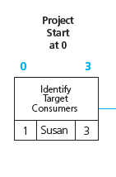
“Identify Target Consumers”
Start date = 0
ES = Start date = 0
Duration = 3
EF = 0 + 3 = 3
Notes:
“Identify Target Consumers”
In the following slides we will see the different activities and forward calculations that go into a consumer market study project.
The project estimated start date is 0 and the duration is three days.
Therefore, the earliest “Identify Target Consumers” can start is time 0, and the earliest it can finish is 3 days later (because its estimated duration is 3 days).

Slide 13
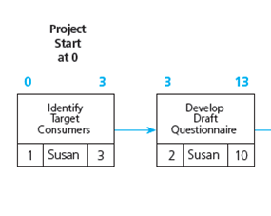
“Develop Draft Questionnaire”
ES = EF Task 1 = 3
Duration = 10
EF = 3 + 10 = 13
Notes:
“Develop Draft Questionnaire”
When “Identify Target Consumers” is finished on day 3, “Develop Draft Questionnaire” can start. It has an estimated duration of 10 days, so its ES is day 3 and its EF is day 13.

Slide 14
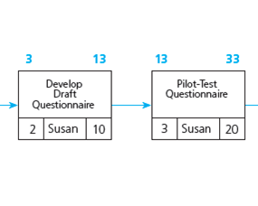
“Pilot-Test Questionnaire”
ES = EF Task 2 = 13
Duration = 20
EF = 13 + 20 = 33
Notes:
“Pilot-Test Questionnaire”
When “Develop Draft Questionnaire” is finished on day 13, “Pilot-Test Questionnaire” can start. It has an estimated duration of 20 days, so its ES is day 13 and its EF is day 33.

Slide 15
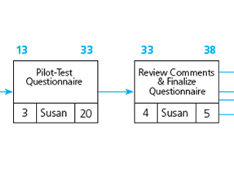
“Review Comments & Finalize Questionnaire”
ES = EF Task 3 = 33
Duration = 5
EF = 33 + 5 = 38
Notes:
“Review Comments & Finalize Questionnaire”
When “Pilot-Test Questionnaire” is finished on day 33, “Review Comments & Finalize Questionnaire” can start. It has an estimated duration of 5 days, so its ES is day 33 and its EF is day 38.

Slide 16
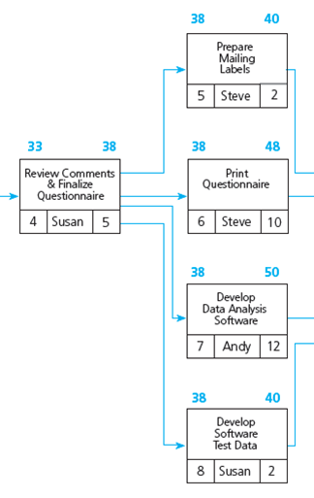
“Prepare Mailing Labels,” “Print Questionnaire,” “Develop Data Analysis Software,” and “Develop Software Test Data”
ES = EF Task 4 = 38
Task 5
Duration = 2
EF = 38 + 2 = 40
Task 6
Duration = 10
EF = 38 + 10 = 48
Task 7
Duration = 12
EF = 38 + 12 = 50
Task 8
Duration = 2
EF = 38 + 2 = 40
Notes:
“Prepare Mailing Labels,” "Print Questionnaire," "Develop Data Analysis Software," and "Develop Software Test Data"
When “Review Comments & Finalize Questionnaire” is finished on day 38, “Prepare Mailing Labels,” "Print Questionnaire," "Develop Data Analysis Software," and "Develop Software Test Data" can all start.
The ES for each activity is 38, but they each have different EFs.
“Prepare Mailing Labels,” has an estimated duration of 2 days, so its EF is day 40.
"Develop Data Analysis Software" has an estimated duration of 10 days, so its EF is day 48.
"Develop Data Analysis Software" has an estimated duration of 12 days, so its EF is day 50.
"Develop Software Test Data" has an estimated duration of 2 days, so its EF is day 40.

Slide 17
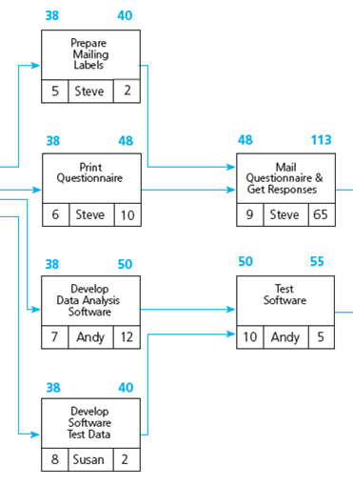
“Mail Questionnaire & Get Responses”
Latest of Tasks 5 and 6 = 48
ES = EF Task 6 = 48
Duration = 65
EF = 48 + 65 = 113
Notes:
“Mail Questionnaire & Get Responses”
When “Prepare Mailing Labels” and "Print Questionnaire" are finished, “Mail Questionnaire & Get Responses” can start.
The later of the two EF times for “Prepare Mailing Labels” and "Print Questionnaire" is 48, therefore this is the ES.
“Mail Questionnaire & Get Responses” has an estimated duration of 65 days, so its ES is day 48 and its EF is day 113.

Slide 18
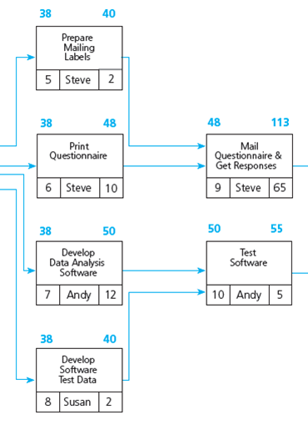
“Test Software”
Latest of Tasks 7 and 8 = 50
ES = EF Task 7 = 50
Duration = 5
EF = 50 + 5 = 55
Notes:
“Test Software”
When "Develop Data Analysis Software" and "Develop Software Test Data" are finished, “Test Software” can start.
The later of the two EF times for “Develop Data Analysis Software" and "Develop Software Test Data" is 50.
"Test Software" has an estimated duration of 5 days, so its ES is day 50 and its EF is day 55.

Slide 19
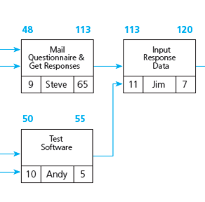
“Input Response Data”
Latest of Tasks 9 and 10 = 113
ES = EF Task 9 = 113
Duration = 7
EF = 113 + 7 = 120
Notes:
“Input Response Data”
When “Mail Questionnaire & Get Responses” and "Test Software" are finished, “Input Response Data” can start.
The later of the two EF times for “Mail Questionnaire & Get Responses” and "Test Software" is 113.
"Input Response Data" has an estimated duration of 7 days, so its ES is day 113 and its EF is day 120.

Slide 20
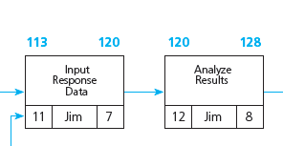
“Analyze Results”
ES = EF Task 11 = 120
Duration = 8
EF = 120 + 8 = 128
Notes:
“Analyze Results”
When “Input Response Data” is finished on day 120, “Analyze Results” can start.
It has an estimated duration of 8 days, so its ES is day 120 and its EF is day 128.

Slide 21
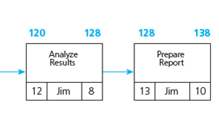
“Prepare Report”
ES = EF Task 12 = 128
Duration = 10
EF = 128 + 10 = 138
Project not complete in required time
Notes:
“Prepare Report”
When “Analyze Results” is finished on day 128, “Prepare Report” can start.
It has an estimated duration of 10 days, so its ES is day 128 and its EF is day 138.
The required completion time for this entire project is 130 days. 138 days is 8 days beyond the required completion time, therefore the project was not completed in the required time.

Slide 22
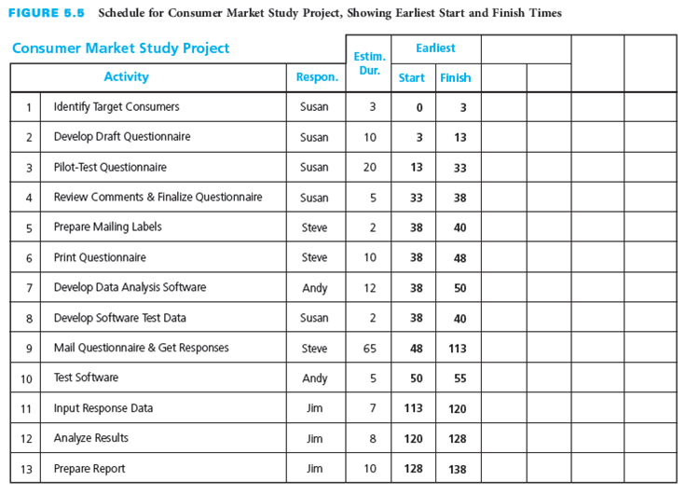
Schedule Table ES and EF
Notes:
Schedule Table ES and EF
This figure depicts the ES and EF times for the consumer market study project we just analyzed, in a schedule table format.

Slide 23
Latest Start and Finish Times
Latest start time (LS)
Latest time by which a specific activity must be started
Latest finish time (LF)
Latest time by which a specific activity must be completed
LS = LF − Estimated Duration
Calculate backward through the network diagram
Notes:
Latest Start and Finish Times
Latest start time (LS) is the latest time by which a specific activity must be started in order for the entire project to be finished by its required completion time.
It is calculated by subtracting the activity’s estimated duration from the activity’s latest finish time.
Latest finish time (LF) is the latest time by which a specific activity must be completed in order for the entire project to be finished by its required completion time.
It is calculated on the basis of the project required completion time and the estimated durations of succeeding activities.
LS = LF– Estimated Duration
Calculate backward through the network diagram from the end of the project to the beginning of the project.

Slide 24
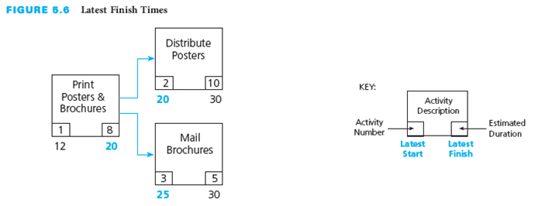
Latest Start and Finish Times Calculation
Why is the LF for “Print Posters & Brochures” 20?
Notes:
Latest Start and Finish Times Calculation
These figures show two activities that emerge directly from an activity labeled, “Print Posters & Brochures.”
This project is required to be completed by day 30. Therefore, “Distribute Posters” must be started by day 20 because it has an estimated duration of 10 days, and “Mail Brochures” must be started by day 25 because it has an estimated duration of 5 days.
The earlier of these two LSs is day 20. Therefore, the latest that “Print Posters & Brochures” can finish is day 20, so that “Distribute Posters” can start by day 20.
Even though “Mail Brochures” does not have to start until day 25, “Print Posters & Brochures” must finish by day 20, or else the entire project will be delayed.
If “Print Posters & Brochures” does not finish until day 25, then “Distribute Brochures” will not be able to start until day 25.
Because “Distribute Brochures” has an estimated duration of 10 days, it will not finish until day 35, which is 5 days beyond the project required completion time.

Slide 25
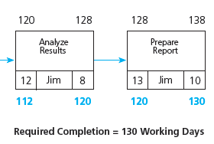
“Prepare Report”
Required completion = 130
LF = Complete date = 130
Duration = 10
LS = 130 − 10 = 120
Notes:
“Prepare Report”
Now let us look at how to set up the backward calculations for the consumer market study project we just analyzed.
The required completion time for the project is 130 working days.
Therefore, the latest that “Prepare Report,” the last activity, can finish is day 130, and the latest that it can start is day 120 because its estimated duration is 10 days.
In order for “Prepare Report” to start on day 120, the latest that “Analyze Results” can finish is day 120. If the LF for “Analyze Results” is day 120, then its LS is day 112 because its estimated duration is 8 days.

Slide 26
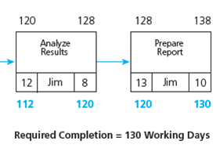
“Analyze Results”
LF = LS Task 13 = 120
Duration = 8
LS = 120 − 8 = 112
Notes:
“Analyze Results”
In order for “Prepare Report” to start on day 120, the latest that “Analyze Results” can finish is day 120.
If the LF for “Analyze Results” is day 120, then its LS is day 112 because its estimated duration is 8 days.
In order for “Analyze Results” to start on day 112, the latest that “Input Response Data” can finish is day 112.

Slide 27
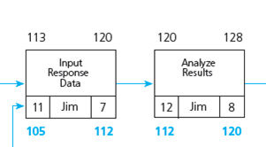
“Input Response Data”
LF = LS Task 12 = 112
Duration = 7
LS = 112 − 7 = 105
Notes:
“Input Response Data”
If the LF for “Input Response Data” is day 112, then its LS is day 105 because its estimated duration is 7 days.
In order for “Analyze Results” to start on day 112, the latest that “Input Response Data” can finish is day 112.
If the LF for “Input Response Data” is day 112, then its LS is day 105 because its estimated duration is 7 days.

Slide 28
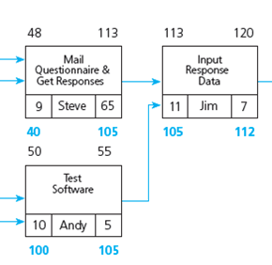
“Test Software” and “Mail Questionnaire & Get Responses”
LF = LS Task 11 = 105
Task 9
Duration = 65
LS = 105 − 65 = 40
Task 10
Duration = 5
LS = 105 − 5 = 100
Notes:
“Test Software” and “Mail Questionnaire & Get Responses”
In order for “Input Response Data” to start on day 105, the latest that “Mail Questionnaire & Get Responses” and "Test Software" can finish is day 105.
If the LF for “Mail Questionnaire & Get Responses” is day 105, then its LS is day 40 because its estimated duration is 65 days. If the LF for "Test Software"” is day 105, then its LS is day 100 because its estimated duration is 5 days.

Slide 29
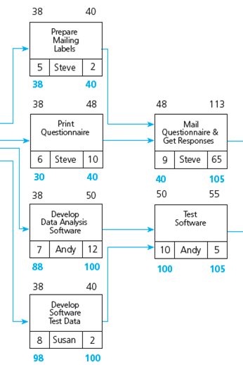
“Develop Data Analysis Software” and “Develop Software Test Data”
LF = LS Task 10 = 100
Task 7
Duration = 12
LS = 100 − 12 = 88
Task 8
Duration = 2
LS = 100 − 2 = 98
Notes:
"Develop Data Analysis Software" and "Develop Software Test Data"
In order for “Test Software” to start on day 100, the latest that "Develop Data Analysis Software" and "Develop Software Test Data" can finish is day 100.
If the LF for “Develop Data Analysis Software” is day 100, then its LS is day 88 because its estimated duration is 12 days.
If the LF for “Develop Software Test Data” is day 100, then its LS is day 98 because its estimated duration is 2 days.

Slide 30
“Prepare Mailing Labels” and "Print Questionnaire”
LF = LS Task 9 = 40
Task 5
Duration = 2
LS = 40 − 2 = 38
Task 6
Duration = 10
LS = 40 − 10 = 30
Notes:
“Prepare Mailing Labels” and "Print Questionnaire”
In order for “Mail Questionnaire & Get Responses” to start on day 40, the latest that “Prepare Mailing Labels” and "Print Questionnaire" can finish is day 40.
If the LF for “Prepare Mailing Labels” is day 40, then its LS is day 38 because its estimated duration is 2 days.
If the LF for “Print Questionnaire” is day 40, then its LS is day 30 because its estimated duration is 10 days.

Slide 31
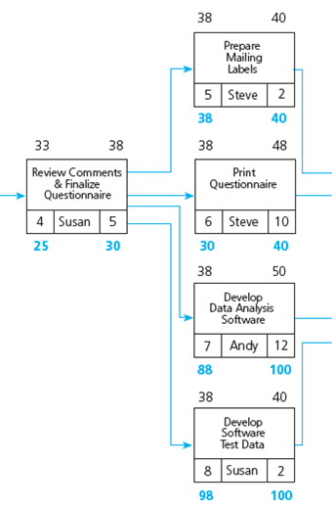
“Review Comments & Finalize Questionnaire”
LF = Earliest LS of Tasks 5, 6, 7, and 8 = 30
LF = LS Task 6 = 30
Duration = 5
LS = 30 − 5 = 25
Notes:
“Review Comments & Finalize Questionnaire”
Look at “Review Comments & Finalize Questionnaire.”
In order for the four activities emerging from this activity to start by their LS times (so that the project can finish by its required completion time of 130 days), “Review Comments & Finalize Questionnaire” must be finished by the earliest LS of all four activities, according to Rule 2.
The earliest of the four LSs is day 30, the latest time by which “Print Questionnaire” must start.
Therefore, the latest that “Review Comments & Finalize Questionnaire” can finish is day 30.
If the LF for “Review Comments & Finalize Questionnaire” is day 30, then its LS is day 25 because its estimated duration is 5 days.

Slide 32
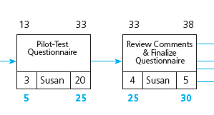
“Pilot-Test Questionnaire”
LF = LS Task 4 = 25
Duration = 20
LS = 25 − 20 = 5
Notes:
“Pilot-Test Questionnaire”
In order for “Review Comments & Finalize Questionnaire” to start on day 25, the latest that “Pilot-Test Questionnaire” can finish is day 25.
If the LF for “Pilot-Test Questionnaire” is day 25, then its LS is day 5 because its estimated duration is 20 days.

Slide 33
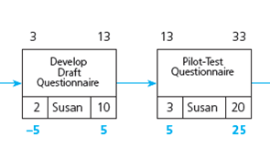
“Develop Draft Questionnaire”
LF = LS Task 3 = 5
Duration = 10
LS = 5 − 10 = −5
Notes:
“Develop Draft Questionnaire”
In order for “Pilot-Test Questionnaire” to start on day 5, the latest that “Develop Draft Questionnaire” can finish is day 5.
If the LF for “Develop Draft Questionnaire” is day 5, then its LS is day -5 because its estimated duration is10 days.

Slide 34
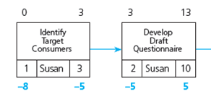
“Identify Target Consumers”
LF = LS Task 2 = −5
Duration = 3
LS = −5 − 3 = −8
Start date = 0
Project is 8 days late at start
Notes:
“Identify Target Consumers”
In order for “Develop Draft Questionnaire” to start on day -5, the latest that “Identify Target Consumers” can finish is day -5.
If the LF for “Input Response Data” is day -5, then its LS is day -8 because its estimated duration is 3 days.
Therefore, the consumer market study project must start 8 days earlier than the planned start date in order to finish in the required 130 days.

Slide 35
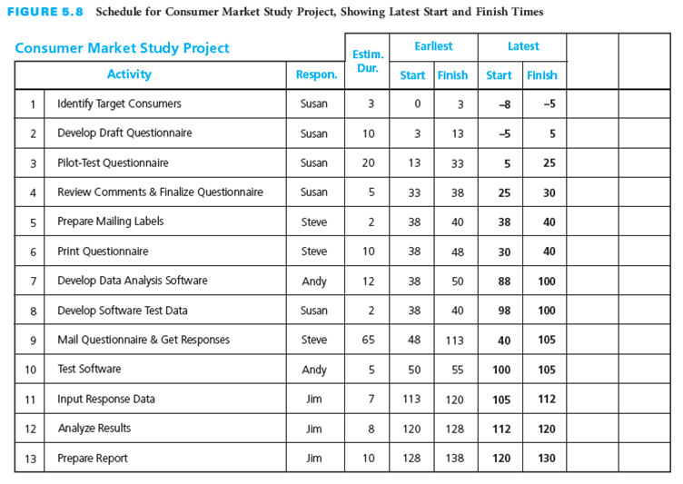
Schedule Table LS and LF
Notes:
Schedule Table LS and LF
Here you see a figure that depicts the schedule table with the LS and LF values added.

Slide 36
Total Slack
Sometimes called float
The difference between EF time of last activity and the project required completion time
Negative slack
Lack of slack over the entire project
Amount of time an activity must be accelerated
Positive slack
Maximum amount of time that the activities on a particular path can be delayed without jeopardizing on-time completion
Notes:
Total Slack
Total slack is sometimes called float.
It is the difference between EF time of last activity and the project required completion time.
Total slack is calculated for each of the activities by finding the difference between the EF time of the activity and the LF of the activity.
You also look at the difference between the ES and LS of the activity.
Negative slack indicates:
A lack of slack over the entire project
The amount of time an activity must be accelerated to complete the project by the required completion time
Positive slack indicates the maximum amount of time that the activities on a particular path can be delayed without jeopardizing completion of the project by the required completion time.
If the total slack is zero, the activities on the path do not need to be accelerated, but cannot be delayed.

Slide 37
Critical Path
Longest path in the overall network diagram
Find which activities have the least amount of slack
Notes:
Critical Path
The critical path is this longest path in the overall network diagram.
One way to determine which activities make up the critical path is to find which ones have the least amount of slack.

Slide 38
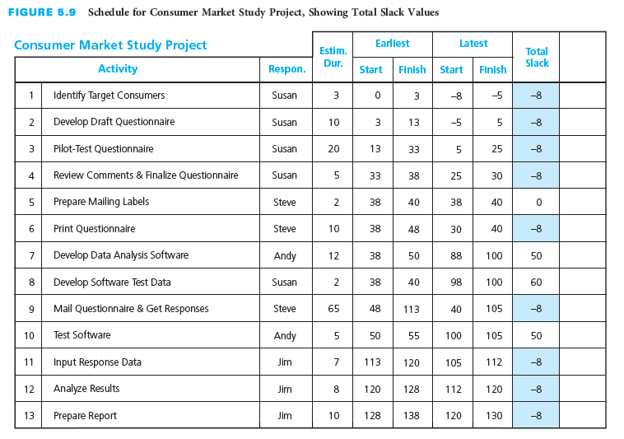
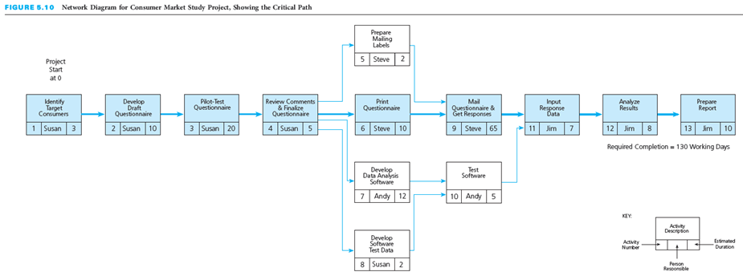
Critical Path Through a Project
Notes:
Critical Path Through a Project
This table shows slack values for each activity in the consumer market study project we just analyzed.
Those with -8 as the total slack are the activities on the critical path.
The figure on the bottom of the slide depicts the critical path through the network diagram for the consumer market study project.

Slide 39
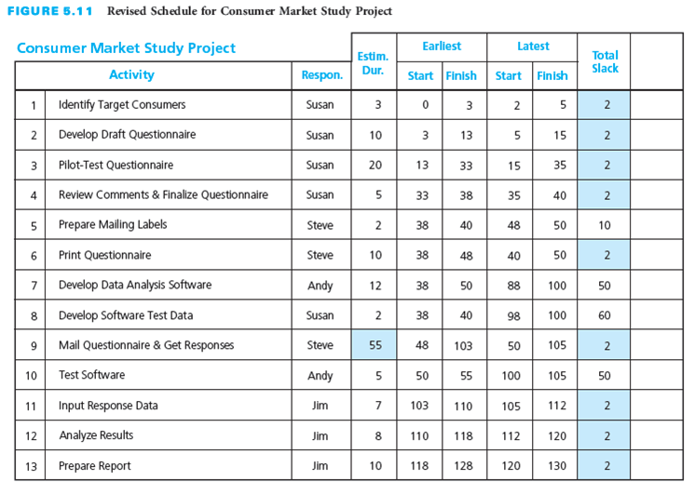
Change in Slack for Critical Path
Notes:
Change in Slack for Critical Path
This figure depicts the change in the critical path if the estimated duration of the Mail Questionnaire & Get Responses task is reduced from 65 days to 55 days.
Note that the tasks on the critical path now have a total slack of 2, the least amount slack in the project.

Slide 40
Free Slack
Time a specific activity can be postponed without delaying the ES of its immediate successor activities
Calculation
Find lowest of the values of total slack for all the activities entering into a specific activity
Subtract value from the values of total slack for the other activities also entering into that same activity
Notes:
Free Slack
Free slack is the amount of time a specific activity can be postponed without delaying the earliest start time of its immediately succeeding activities.
Free slack is calculated by:
Finding the lowest of the values of total slack for all the activities entering into a specific activity
Then subtracting that value from the values of total slack for the other activities also entering into that same activity

Slide 41

Total Slack Compared to Free Slack
Total slack for Activity 7 = 50
Total slack for Activity 8 = 60
Free slack for Activity 8 = 60 − 50 = 10 days
Notes:
Total Slack compared to Free Slack
Let’s look at an example of free slack.
Activities 7 and 8 are predecessors for Activity 10 in the figure above.
The values of total slack for activities 7 and 8 are 50 and 60 days, respectively.
The lesser of these two values is 50 days.
Therefore, activity 8, “Develop Software Test Data,” has a free slack of 10 days (60 – 50 = 10) and can slip by up to that amount without delaying the earliest start time of activity 10, “Test Software.”

Slide 42
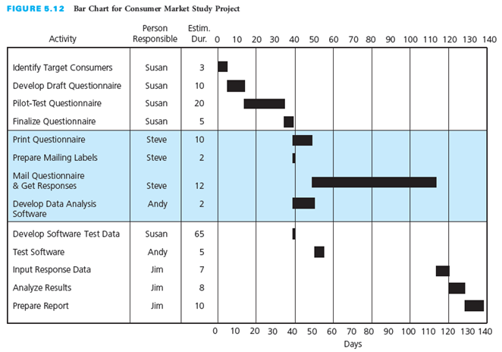
Bar Chart Format
Gantt chart tool for planning and scheduling
Activities on side
Time scale on top or bottom
Estimated duration in bars
Automatically generated in software systems
Can show relationships between activities
Notes:
Bar Chart Format
A Gantt chart is the name commonly used for the type of bar chart tool employed in planning and scheduling.
As you can see in the Gantt chart on this slide, the activities are listed on the left-hand side and there is a time scale along the bottom or the top.
The estimated duration for each activity is indicated by a bar spanning the period during which the activity is expected to be accomplished.
Gantt charts often also have a column that indicates who is responsible for each task.
This Gantt chart depicts the consumer market study project that we have been analyzing.
You can probably see how this is an easy way to visually represent when activities are scheduled to occur during a project.
A Gantt chart is a traditional bar chart in that it does not graphically display the dependent relationships of activities.
Be sure to create the network diagram and connect the bars in the Gantt chart with arrows to show relationships.
Project management software can automatically generate a time-scaled bar chart from the schedule table that is based on the network diagram.

Slide 43
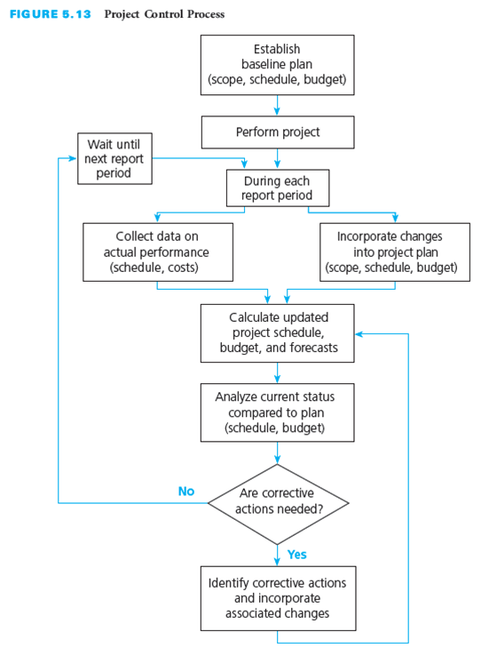
Project Control Process
Meetings occur regularly
Gather data on actual performance
Record changes
Monitor progress
Notes:
Project Control Process
Here you see a figure that illustrates the steps in the project control process.
The project control process starts with establishing a baseline plan that shows how the project scope will be accomplished on schedule and within budget.
Once this baseline plan is agreed upon by the customer and the contractor or project team, the project work can be performed.
It is necessary to monitor the progress to ensure that everything is going according to the plan.
The project control process involves regularly gathering data on project performance, comparing actual performance to planned performance, and taking corrective action immediately if actual performance lags behind planned performance.
This process must occur regularly throughout the project.
Establish regular reporting meetings to compare actual to planned progress.
Gather data on actual performance.
Record information on changes to the project scope, schedule, and budget.
The key to effective project control is measuring actual progress and comparing it to planned progress on a timely and regular basis and taking any needed corrective action immediately.
Project management is a proactive approach to controlling a project to ensure that the project objective is accomplished, even when things do not go according to plan.

Slide 44
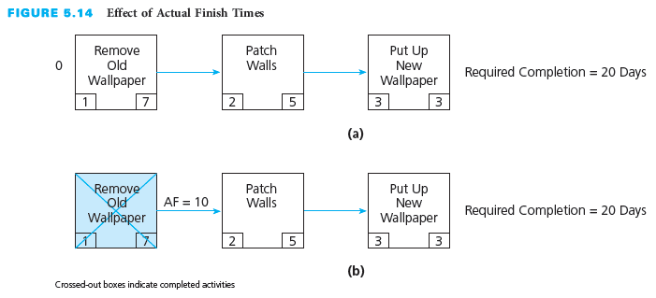
Effects of Actual Schedule Performance
Part (a) Total slack = +5
Part (b) Total slack = +2
Notes:
Effects of Actual Schedule Performance
As you probably know from real-life experience, some activities get completed on time, some are finished ahead of schedule, and others are completed later than scheduled.
The actual finish times (AFs) of completed activities will determine the earliest start and earliest finish times for the remaining activities in the network diagram, as well as the total slack.
This figure depicts the planned and actual performance of a project to remove old wallpaper and install new wallpaper.
Part (a) of the figure is a network diagram for a simple project. It shows that the earliest the project can finish is day 15 (the sum of the estimated durations of the three activities, 7 + 5 + 3).
Since the required completion time is day 20, the project has a total slack of +5 days.
Suppose that activity 1, “Remove Old Wallpaper,” is actually finished on day 10, rather than on day 7 as planned, because it turns out to be more difficult than anticipated.
Part (b) of the figure depicts this deviation from the original plan.
The earliest start and finish times for activities 2 and 3 will be 3 days later than on the original schedule.
Because “Remove Old Wallpaper” is actually finished on day 10, the ES for “Patch Walls” will be day 10 and its EF will be day 15.
Following through with the forward calculations, we find that “Put Up New Wallpaper” will have an ES of day 15 and an EF of day 18.
Comparing this new EF of the last activity to the required completion time of day 20, we find a difference of 2 days. The total slack got worse—it changed in a negative direction, from +5 days to +2 days.
This example illustrates how the actual finish times of activities have a ripple effect, altering the remaining activities’ earliest start and finish times and the total slack.

Slide 45
Incorporate Changes into Schedule
Changes may impact the schedule
Initiated by customer or project team
Result from unanticipated occurrence
Early change may have less impact than later change
Manage requested changes
Estimate impact
Obtain customer approval
Revise project plan, schedule, and costs
Notes:
Incorporate Changes into Schedule
Throughout a project, changes may occur that impact the schedule.
Changes might be initiated by the customer or the project team, or they might be the result of an unanticipated occurrence.
Changes requested early in the project may have less of an impact on schedule and budget than those requested later in the project.
When the customer requests a change, the contractor or project team should estimate the impact on the project schedule and budget and then obtain customer approval before proceeding.
If the customer approves the proposed revisions to the project schedule and budget, then any additional activities, revised estimated durations, and revised estimated resources and associated costs should be incorporated into the project schedule and budget.
With respect to the project schedule, changes can result in the addition or deletion of activities, re-sequencing of activities, changes to estimated durations for specific activities, or a new required completion time for the project.

Slide 46
Update Project Schedule
Generate forecasts for project finish
Use actual finish dates of completed activities
Enter project changes
Update project schedule
Determine if any changes occur in critical path
Notes:
Update Project Schedule
An updated project schedule should be generated regularly that forecasts whether the project will finish ahead of or behind its required completion time, or on time.
Once data have been collected on the actual finish times of completed activities and the effects of any project changes, an updated project schedule can be calculated.
Earliest start and finish times for the remaining, uncompleted, activities are calculated by working forward through the network.
They are based on the actual finish times of completed activities and the estimated durations of the uncompleted activities.
The latest start and finish times for the uncompleted activities are calculated by working backward through the network.
An important part of updating project schedules is determining if any changes have occurred on the critical path.

Slide 47
Control Schedule
Schedule Control Steps
Actions
Analyze the schedule for needed corrective action
Decide specific corrective actions to be taken
Revise the plan to incorporate corrective actions
Recalculate the schedule to evaluate the effects of the planned corrective actions
Repeat steps if not acceptable results
Apply efforts to paths with negative slack
Near-term activities
Long estimated durations
Change may shift critical path
Trade-off of costs and scope
Notes:
Control Schedule
Schedule control involves four steps:
Analyzing the schedule to determine which areas may need corrective action
Deciding what specific corrective actions should be taken
Revising the plan to incorporate the chosen corrective actions
Recalculating the schedule to evaluate the effects of the planned corrective actions
If the planned corrective actions do not result in an acceptable schedule, these steps need to be repeated.
A concentrated effort to accelerate project progress must be applied to the paths with negative slack.
Activities that are near term (that is, that are in progress or to be started in the immediate future)
Activities that have long estimated durations
The amount of slack should determine the priority with which these concentrated efforts are applied.
A change in the estimated duration of any activity on that path will cause a corresponding change in the slack for that path and may shift the critical path.
Eliminating negative slack by reducing durations of activities will involve a trade-off in the form of an increase in costs or a reduction in the scope of the project.

Slide 48
Scheduling for Information Systems Development
Common problems
Failure to identify all user requirements
Failure to identify user requirements properly
Continuing growth of project scope
Underestimating learning curves for new software packages
Incompatible hardware
Logical design flaws
Poor selection of software
Failure to select the best design strategy
Data incompatibility issues
Failure to perform all phases of the SDLC
Notes:
Scheduling for Information Systems Development
Scheduling the development of an information system is a challenging process.
Scheduling is often done in a haphazard manner, and, as a result, a large number of IS projects are finished much later than originally promised– or never finished at all.
Among the common problems that often push IS development projects beyond their required completion time are:
Failure to identify all user requirements
Failure to identify user requirements properly
Continuing growth of project scope
Underestimating learning curves for new software packages
Incompatible hardware
Logical design flaws
Poor selection of software
Failure to select the best design strategy
Data incompatibility issues
Failure to perform all phases of the SDLC

Slide 49
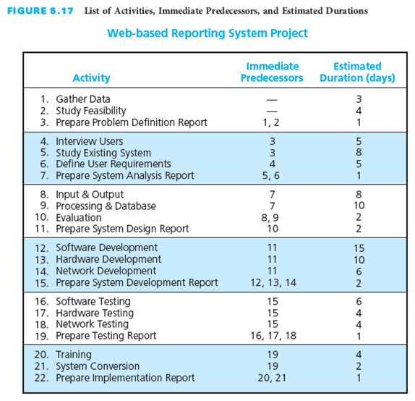
IS Example: Activities, Predecessors, Durations
Notes:
IS Example: Activities, Predecessors, Durations
This figure depicts a list of activities, immediate predecessors, and estimated durations for the web-based reporting system project.
The project is required to be completed in 50 days, and it needs to be started as soon as possible.
Ask: Do you think the project can be completed in 50 days?

Slide 50
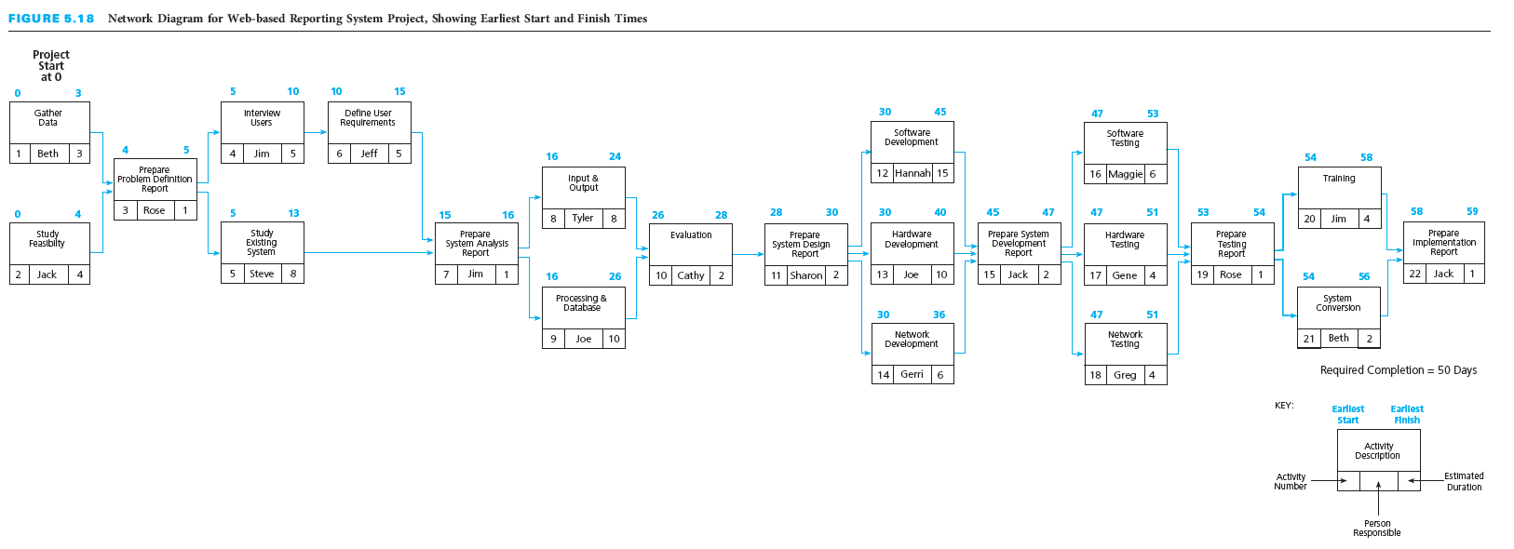
IS Example: ES and EF Times
Notes:
IS Example: ES and EF Times
Here you see the ES and EF times for each activity in the web-based reporting system project.
Ask: Can you explain the different ES and EF values for the activities?

Slide 51
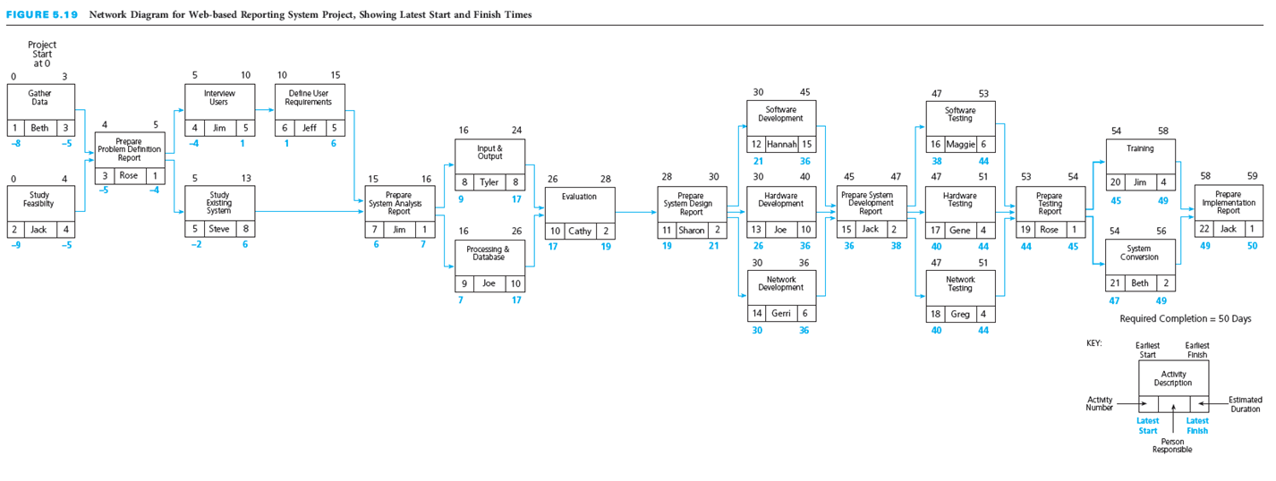
IS Example: LS and LF Times
Notes:
IS Example: LS and LF Times
This figure depicts the LS and LF times for each activity.
Ask: Can you explain the LS and LF values for the activities?

Slide 52
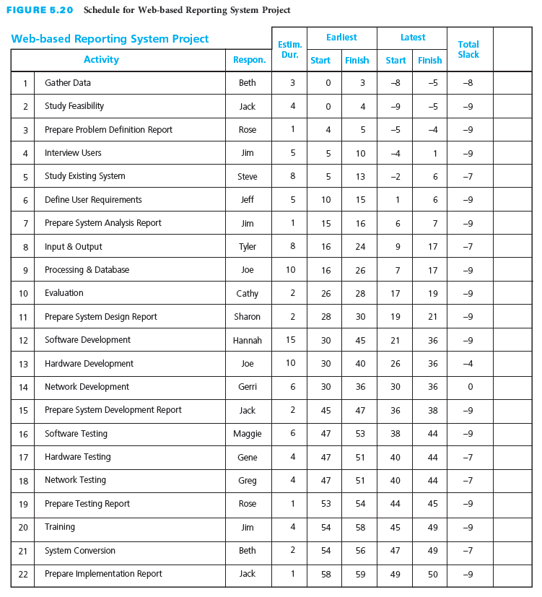
IS Example: Schedule Table
Notes:
IS Example: Schedule Table
This table depicts the project schedule table with the calculated total slack values for each activity.
Ask: Take a minute to analyze this. What is the critical path? How can the project be finished in 50 days?

Slide 53
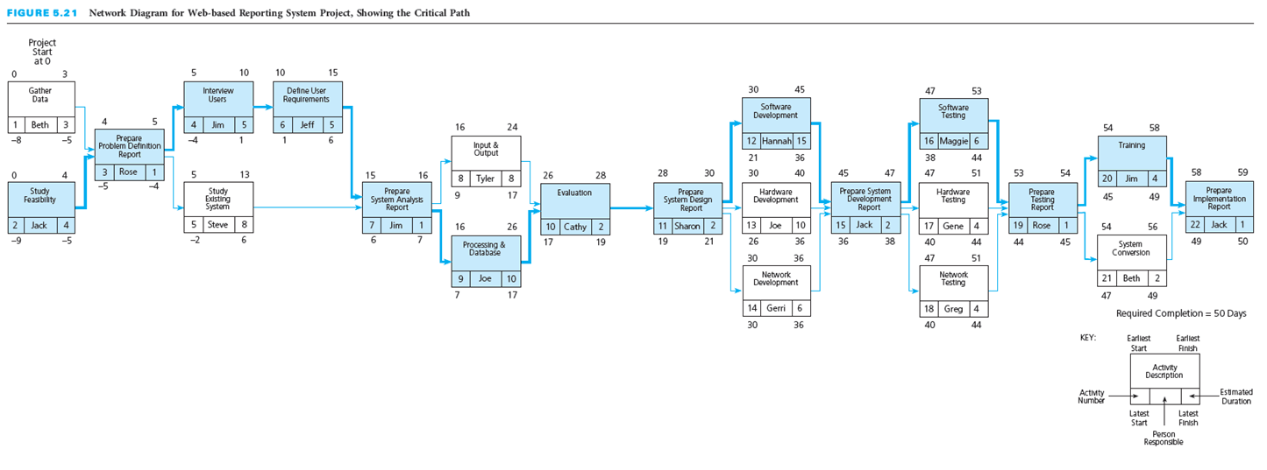
IS Example: Critical Path
Notes:
IS Example: Critical Path
This figure provides you with a visual representation of the critical path for the development project.
The team must determine a way to reduce the development time by 9 days, request that the project completion date be extended from 50 to 59 days, or find some compromise.
After extensive discussions with upper management, in which she stressed the importance of developing the system right the first time and not having to rush through some critical phases of the SDLC, Beth convinced her superiors to extend the project completion time to 60 days.

Slide 54
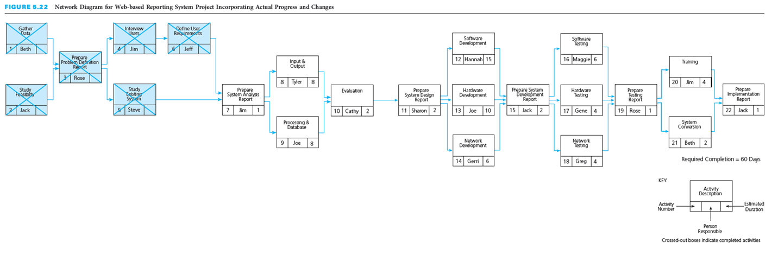
IS Example: Updated Network Diagram
Notes:
IS Example: Updated Network Diagram
Beth and her team proceeded with the project and completed activities 1 through 6:
Activity 1, “Gather Data,” actually finished on day 4
Activity 2, “Study Feasibility,” actually finished on day 4
Activity 3, “Prepare Problem Definition Report,” actually finished on day 5
Activity 4, “Interview Users,” actually finished on day 10
Activity 5, “Study Existing System,” actually finished on day 15
Activity 6, “Define User Requirements,” actually finished on day 18
They then discovered that, by using some existing software for the database, they could reduce the estimated duration of activity 9, “Processing & Database,” from 10 days to 8 days. The figure above shows the updated network diagram.

Slide 55
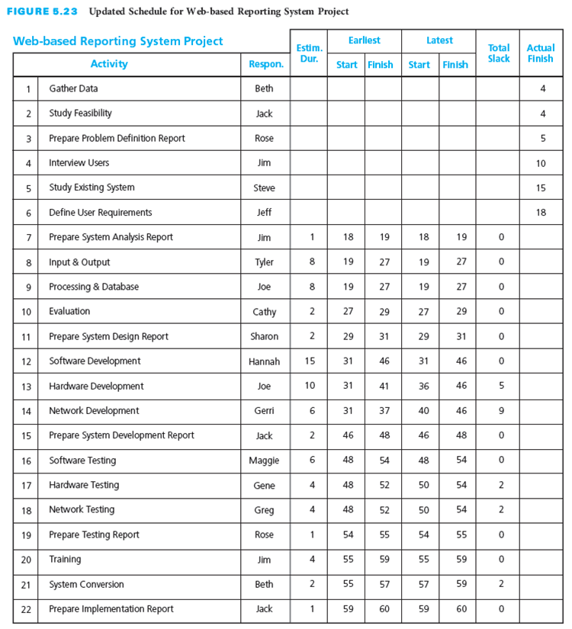
IS Example: Updated Schedule Table
Notes:
IS Example: Updated Schedule Table
Here you see the updated project schedule.
Note that the critical path has now been reduced to zero with the updates and changes.

Slide 56
Project Management Information Systems
Most systems perform scheduling functions
Calculates at click of the mouse
ES, EF, LS, and LF
Total slack
Critical path
Perform control functions
Notes:
Project Management Information Systems
Almost all project management information systems allow you to perform the scheduling functions identified in this chapter.
Software will also calculate ES, EF, LS, and LF times, total and free slack, and the critical path
It is important, however, for the project manager to understand what these terms are and what the calculations mean
Do not rely on computers too much!
Virtually all project management information systems also allow you to perform the control functions identified in this chapter.
While an activity is in progress or once an activity has been completed, current information can be entered into the system and the software will automatically revise the project schedule.

Slide 57
Agile Project Management
Scrum approach participants
Process includes
Product owner
Development team
Scrum master
Establish and authorize
Define requirements
Conduct daily Scrum meetings
Conduct sprint review meeting
Conduct sprint retrospective meeting
Notes:
13. Agile Project Management
Agile project management is an approach to reduce product development time while minimizing risk through continuous interaction between the customer and small self-organizing teams that produce increments of working product features in short time iterations while rapidly adapting to changes in requirements.
The roles of the participants involved in the scrum approach include
A product owner, also referred to as the customer representative, is responsible for defining the customer requirements and product features and for ensuring that the development team delivers an end product with the required features.
The development team develops, delivers, and demonstrates working product increments (portions or modules of the overall end product that is being developed) for specific product features or requirements during a fixed timeframe, called a sprint, also referred to as an iteration.
A Scrum master is a facilitator for the Scrum development process during a sprint whose primary job is to take actions to remove or reduce any obstacles, barriers, or constraints that are impeding progress of the development team toward accomplishing their work tasks and that may negatively impact the successful production and demonstration of a deliverable working product increment by the end of the sprint time.
The agile project management process includes
1. Establishing the rationale, description, funding amount, and target completion date for the final end product (deliverable) and authorizing the project.
2. Defining the product requirements and creating an ordered product backlog of prioritized specific requirements and product features.
3. At the beginning of each sprint the product owner and the development team have a sprint planning meeting to select a set of requirements or features from the top of the product backlog that will be released to the team and that can be produced and demonstrated by the team during the fixed timeframe for the sprint cycle.
4. At the start of each day the development team has a daily Scrum meeting, also referred to as the daily standup as these meetings are usually limited to 15 minutes. Each team member is expected to come prepared to state what they did the previous day, what they plan to do today, and any obstacles that are impeding their work.
5. At the end of the sprint, there is a sprint review meeting at which the development team reviews the work that has been accomplished as well as which items were not completed.
6. At the end of the sprint, there is also a sprint retrospective meeting during which the Scrum team, including the product owner, evaluates performance during the sprint regarding what went well and what could be improved in future sprints.

Slide 58
Critical Success Factors
The person who will be responsible for performing the activity should estimate the duration for that activity. This generates commitment from the person.
The estimated duration for an activity must be based on the types and quantities of resources required to perform the activity.
Activity estimated durations should be aggressive yet realistic.
Activities should not be longer in estimated duration than the time intervals at which the actual progress will be reviewed and compared to planned progress.
Project management involves a proactive approach to controlling a project to ensure that the project objective is accomplished even when things do not go according to plan.
Once the project starts, it is important to monitor progress to ensure that everything is going according to plan.
The key to effective project control is measuring actual progress and comparing it to planned progress on a timely and regular basis and taking any needed corrective action immediately.
The key to effective schedule control is to address any paths with negative or deteriorating slack values aggressively as soon as they are identified. A concentrated effort to accelerate project progress must be applied to these paths.
Notes:
The person who will be responsible for performing the activity should estimate the duration for that activity. This generates commitment from the person.
The estimated duration for an activity must be based on the types and quantities of resources required to perform the activity.
Activity estimated durations should be aggressive yet realistic.
Activities should not be longer in estimated duration than the time intervals at which the actual progress will be reviewed and compared to planned progress.
Project management involves a proactive approach to controlling a project to ensure that the project objective is accomplished even when things do not go according to plan.
Once the project starts, it is important to monitor progress to ensure that everything is going according to plan.
The key to effective project control is measuring actual progress and comparing it to planned progress on a timely and regular basis and taking any needed corrective action immediately.
The key to effective schedule control is to address any paths with negative or deteriorating slack values aggressively as soon as they are identified. A concentrated effort to accelerate project progress must be applied to these paths.

Slide 59
Critical Success Factors (continued)
The amount of negative slack should determine the priority for applying these concentrated efforts.
When attempting to reduce the duration of a path of activities that has negative slack, focus on activities that are near term and on activities that have long estimated durations.
Addressing schedule problems early will minimize the negative impact on scope and budget.
If a project falls too far behind, getting it back on schedule becomes more difficult, and usually requires spending more money or reducing the scope or quality.
If corrective actions are necessary, decisions must be made regarding a trade-off of scope, time, and cost.
A regular reporting period should be established for comparing actual progress to planned progress.
The shorter the reporting period, the better the chances of identifying problems early and taking corrective actions.
During each reporting period, data on actual performance and information on changes to the project scope, schedule, and budget need to be collected in a timely manner and used to calculate an updated schedule and budget.
Notes:
The amount of negative slack should determine the priority for applying these concentrated efforts.
When attempting to reduce the duration of a path of activities that has negative slack, focus on activities that are near term and on activities that have long estimated durations.
Addressing schedule problems early will minimize the negative impact on scope and budget.
If a project falls too far behind, getting it back on schedule becomes more difficult, and usually requires spending more money or reducing the scope or quality.
If corrective actions are necessary, decisions must be made regarding a trade-off of scope, time, and cost.
A regular reporting period should be established for comparing actual progress to planned progress.
The shorter the reporting period, the better the chances of identifying problems early and taking corrective actions.
During each reporting period, data on actual performance and information on changes to the project scope, schedule, and budget need to be collected in a timely manner and used to calculate an updated schedule and budget.

Slide 60
Summary
The scheduling function depends on the planning function.
The estimated types and quantities of resources required for an activity, together with the availability of those resources, will influence the estimated duration for how long it will take to perform the activity.
The estimated duration for each activity must be the total elapsed time—the time for the work to be done plus any associated waiting time.
The estimate should be aggressive yet realistic.
It may be easier to estimate the durations for near-term activities, but as the project progresses, the project team can progressively elaborate the estimated the durations as more information becomes known to allow for more accurate estimated durations.
A project schedule provides a timetable for each activity and shows the earliest start (ES) and earliest finish (EF) times and the latest start (LS) and latest finish (LF) times for each activity.
The total slack for a particular path of activities through the network is common to and shared among all activities on that path.
Notes:
The scheduling function depends on the planning function.
The estimated types and quantities of resources required for an activity, together with the availability of those resources, will influence the estimated duration for how long it will take to perform the activity.
The estimated duration for each activity must be the total elapsed time—the time for the work to be done plus any associated waiting time.
The estimate should be aggressive yet realistic.
It may be easier to estimate the durations for near-term activities, but as the project progresses, the project team can progressively elaborate the estimated the durations as more information becomes known to allow for more accurate estimated durations.
A project schedule provides a timetable for each activity and shows the earliest start (ES) and earliest finish (EF) times and the latest start (LS) and latest finish (LF) times for each activity.
The total slack for a particular path of activities through the network is common to and shared among all activities on that path.

Slide 61
Summary (continued)
The critical path is the longest (most time-consuming) path of activities in the network diagram.
The key to effective project control is measuring actual progress and comparing it to planned progress on a timely and regular basis and taking any needed corrective action immediately.
Actual progress—whether faster or slower than planned—will have an effect on the schedule of the remaining, incomplete activities of the project.
Any type of change—whether initiated by the customer, the contractor, the project manager, a team member, or an unanticipated event—will require a modification to the plan in terms of scope, schedule, and/or budget.
Schedule control involves four steps: analyzing the schedule to determine which areas may need corrective action, deciding what specific corrective actions should be taken, revising the plan to incorporate the chosen corrective actions, and recalculating the schedule to evaluate the effects of the planned corrective actions.
One of the most important factors in effective scheduling is estimating activity durations that are as realistic as possible.
Notes:
The critical path is the longest (most time-consuming) path of activities in the network diagram.
The key to effective project control is measuring actual progress and comparing it to planned progress on a timely and regular basis and taking any needed corrective action immediately.
Actual progress—whether faster or slower than planned—will have an effect on the schedule of the remaining, incomplete activities of the project.
Any type of change—whether initiated by the customer, the contractor, the project manager, a team member, or an unanticipated event—will require a modification to the plan in terms of scope, schedule, and/or budget.
Schedule control involves four steps: analyzing the schedule to determine which areas may need corrective action, deciding what specific corrective actions should be taken, revising the plan to incorporate the chosen corrective actions, and recalculating the schedule to evaluate the effects of the planned corrective actions.
One of the most important factors in effective scheduling is estimating activity durations that are as realistic as possible.

